Slide 1
City of Fort Lauderdale Aquatic Center Construction Project • • Parks and Recreation Board Presentation February 23, 2022
FLAC
Notes:
Brooke – Ruben | Graphics

Slide 2
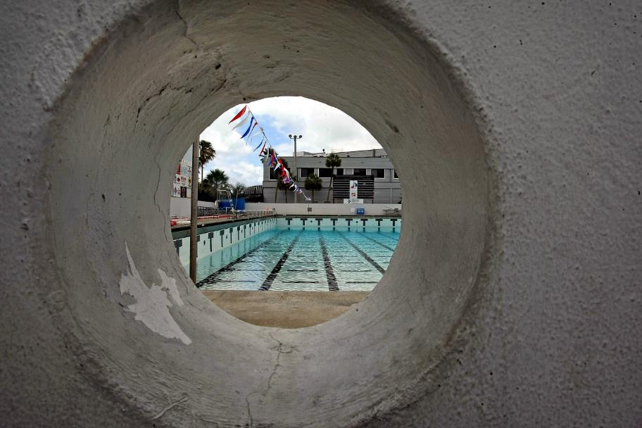
Project Goals
Update & Refresh to Facilities for:
Competitive Standards
Recreational Fitness
Re-establish venue as the center of swimming
Notes:
Cory
Change the airplane bullets

Slide 3
Project Design

Slide 4
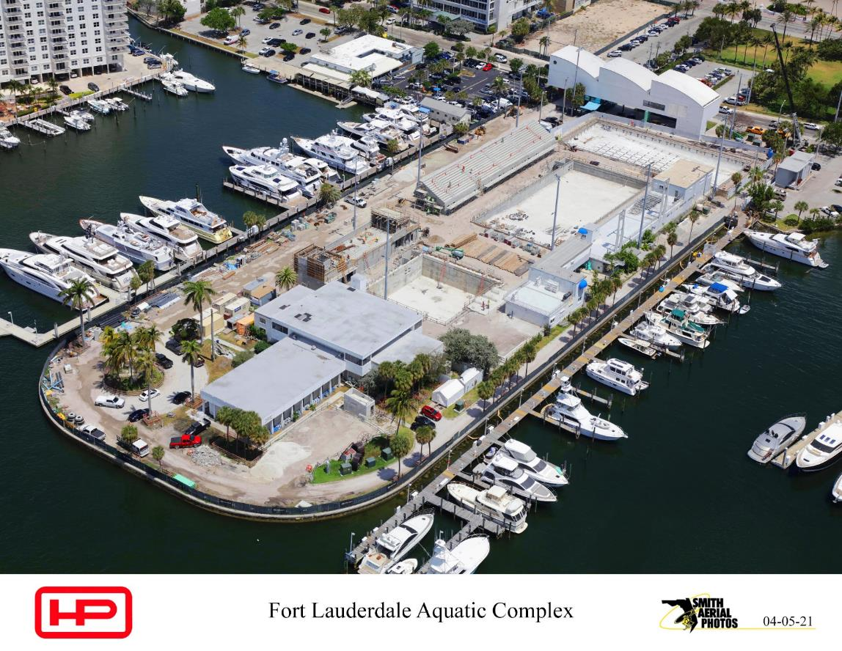
April 2021
Notes:
Greg

Slide 5
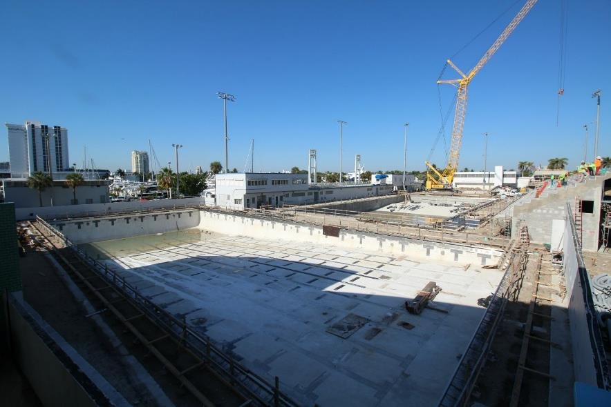
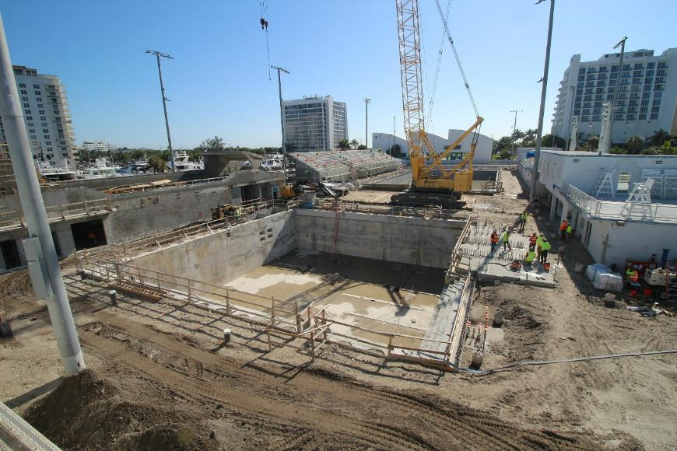
April 2021
Notes:
Greg

Slide 6
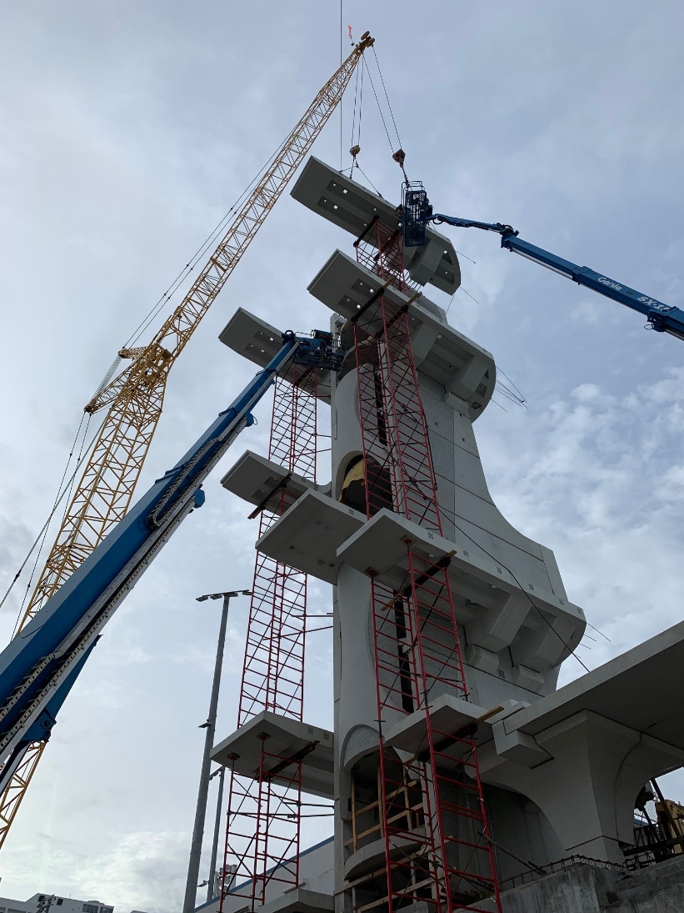
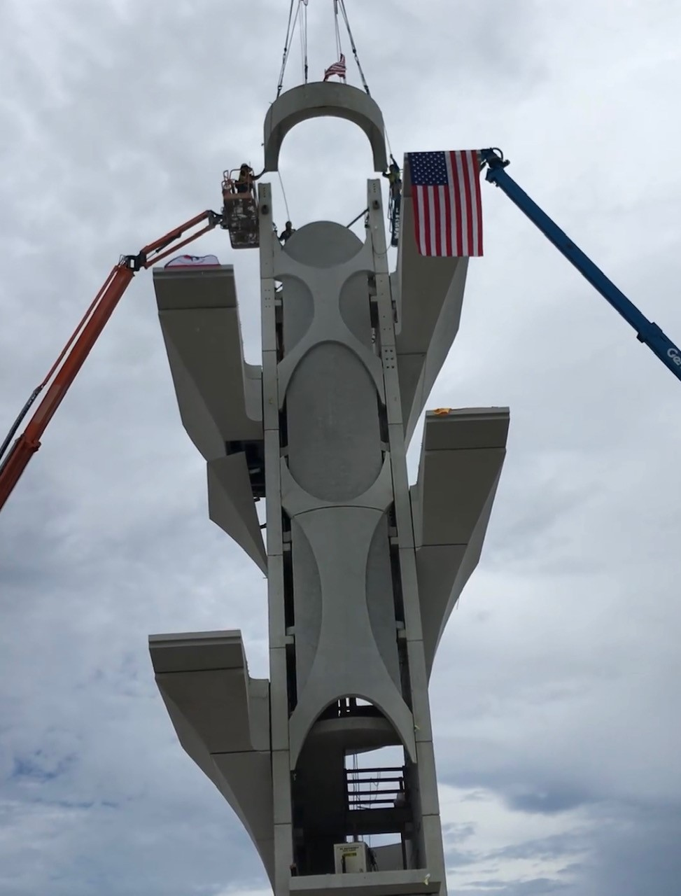
July 2021

Slide 7
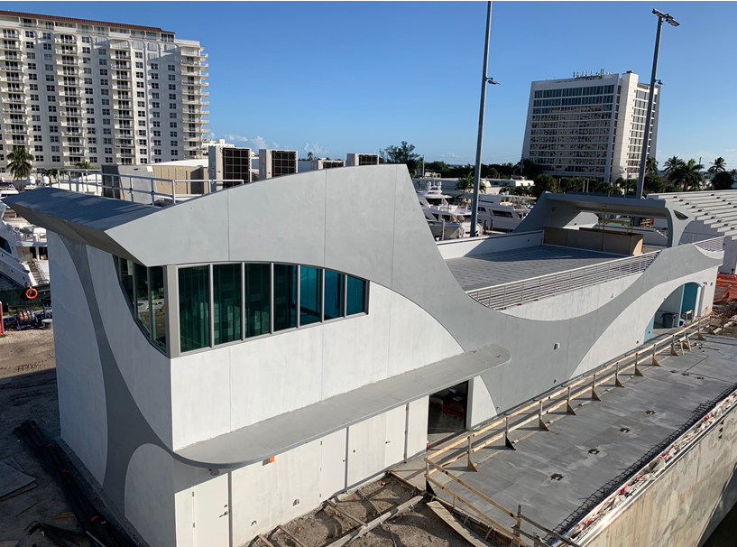
December 2021

Slide 8
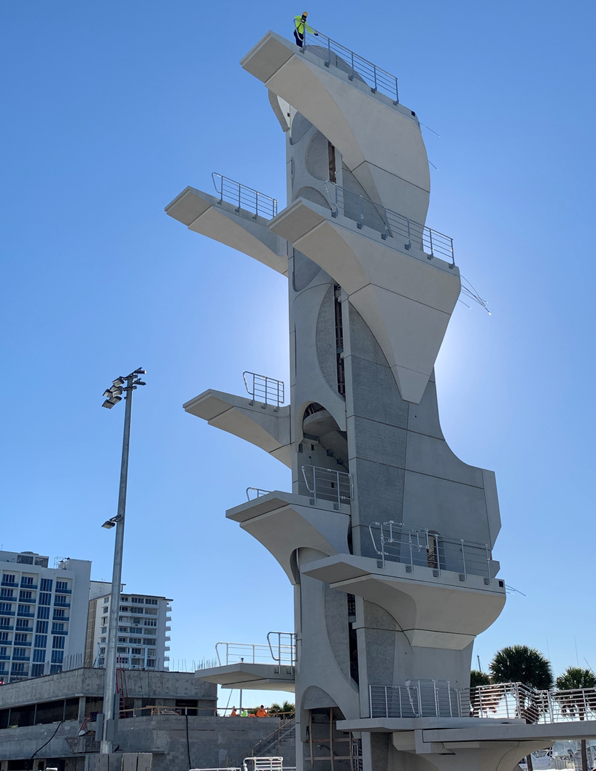
January 2022

Slide 9
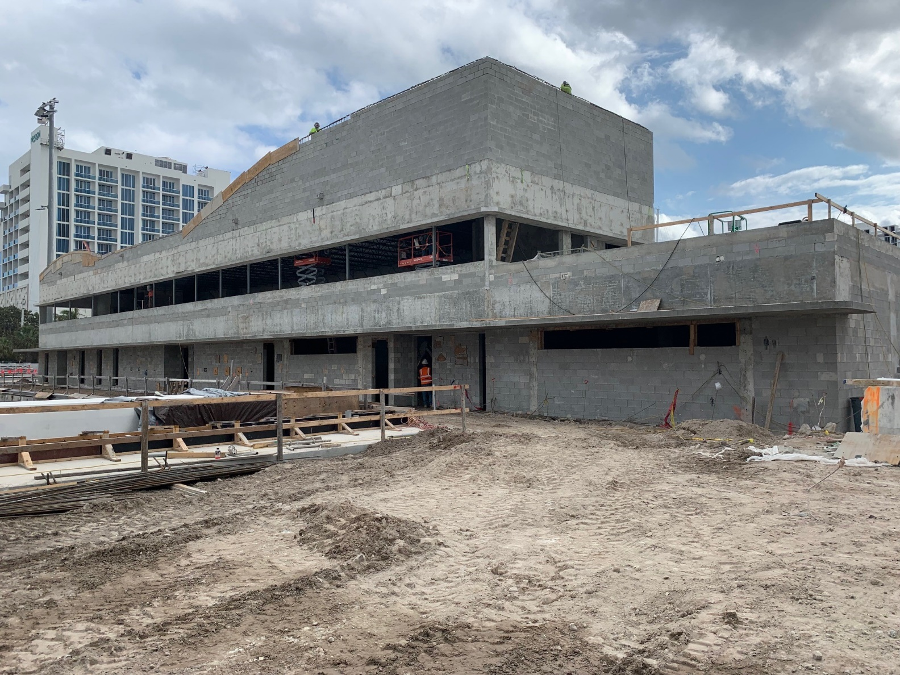
January 2022

Slide 10
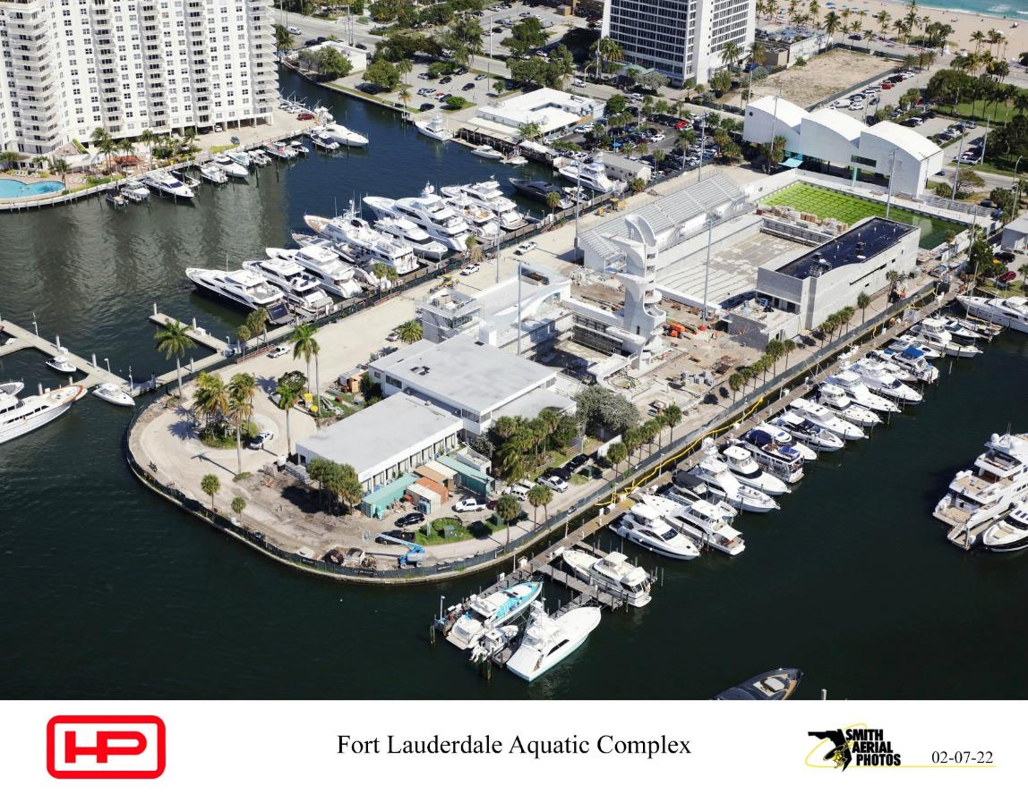
February 2022
Notes:
Greg

Slide 11
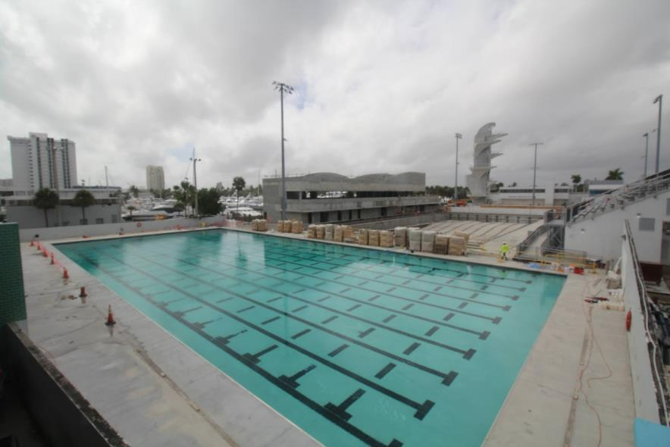
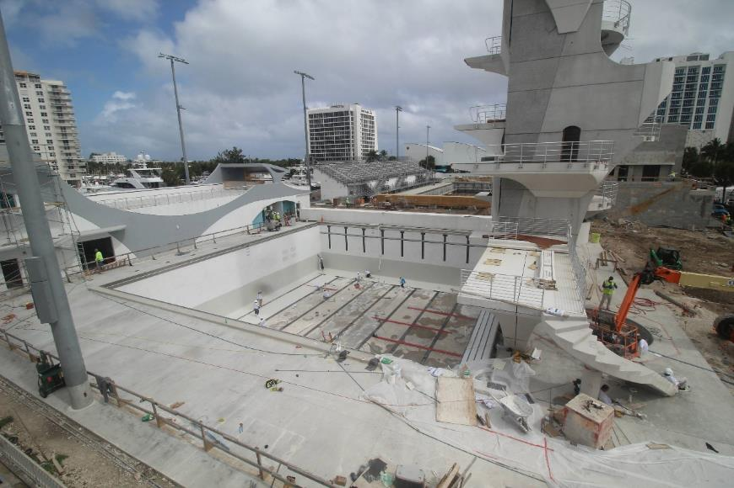
Project To Date
Notes:
Greg

Slide 12
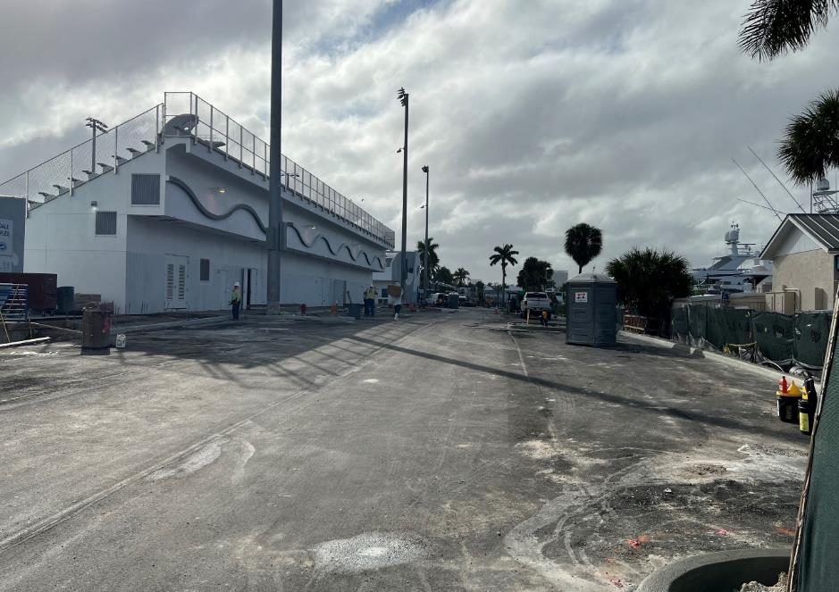
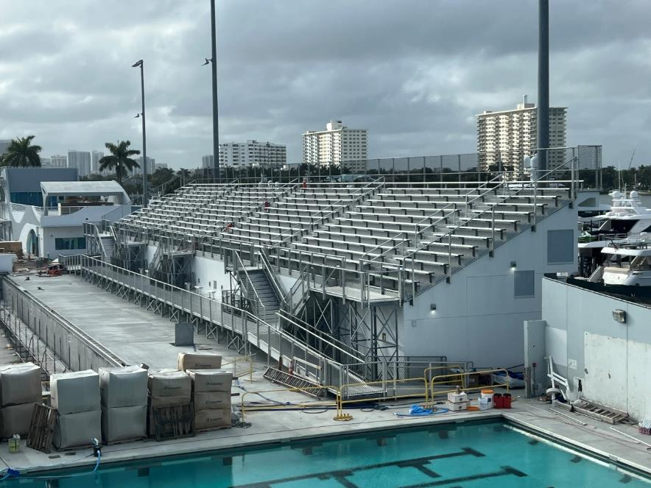
Project To Date
Notes:
Greg

Slide 13
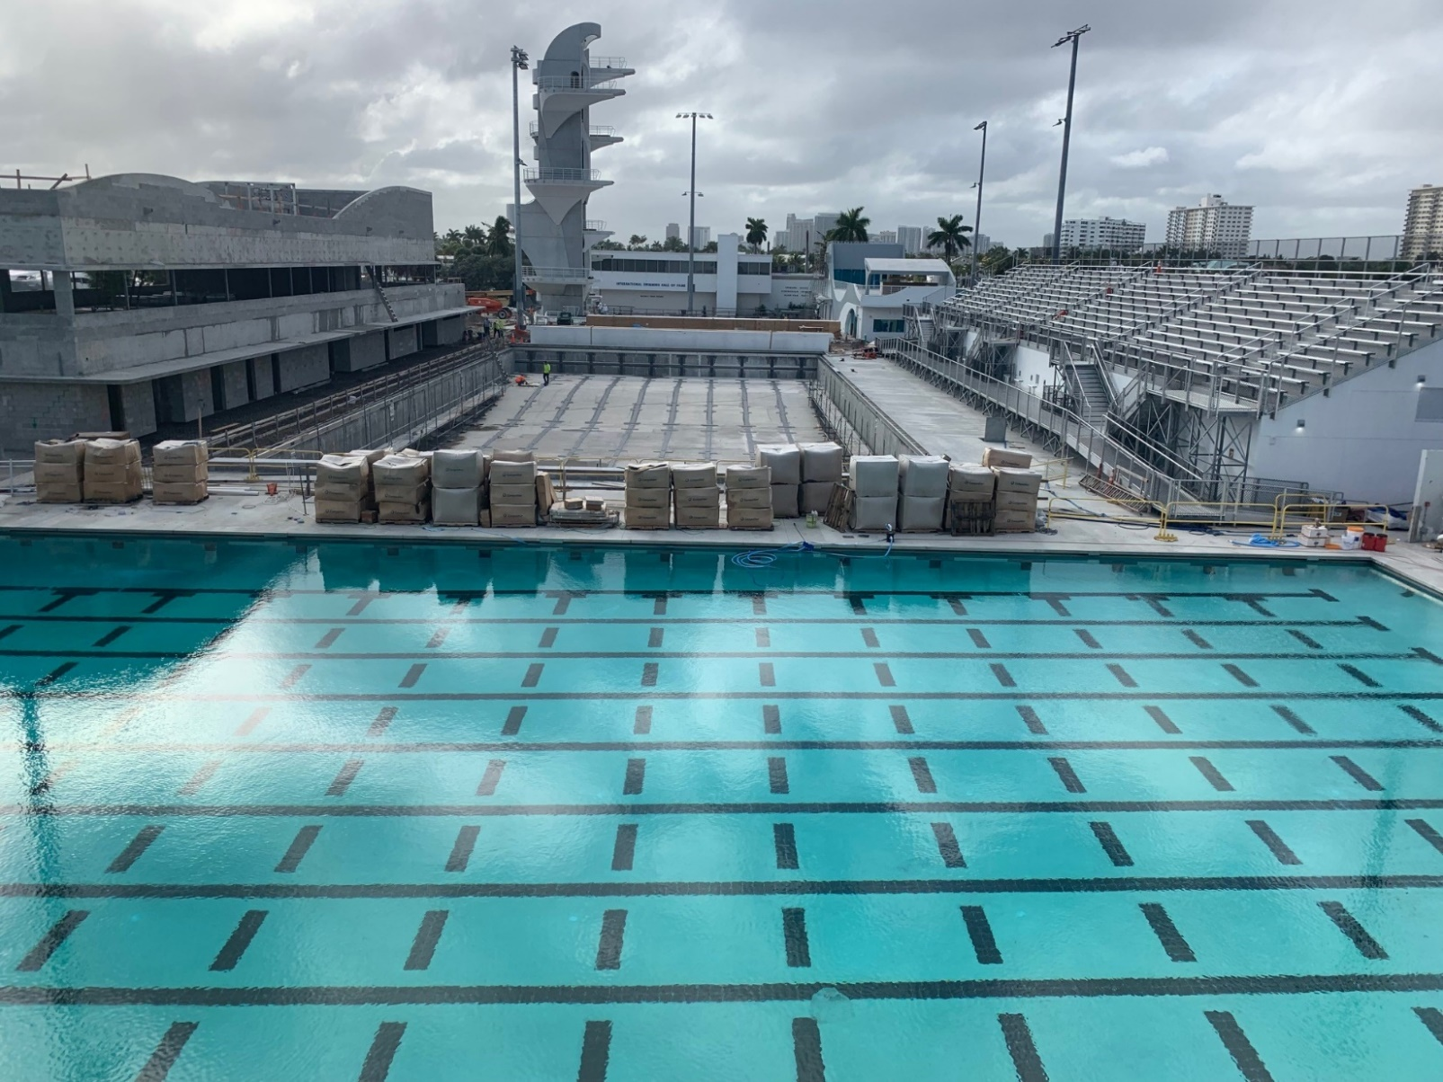
February 17, 2022

Slide 14
Aquatic Center Project Schedule
Complete Pool Plaster / Fill Pools – February 2022
Pool Equipment Startup – March 2022
Complete Pool Decks – March 2022
Temporary Certificate of Occupancy – March 2022
Final Completion – April 2022
Notes:
Greg

Slide 15
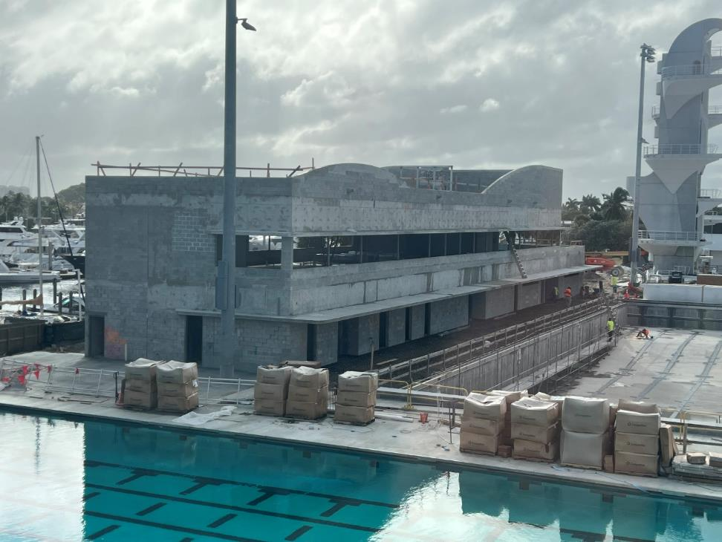
South Building
Notes:
Greg

Slide 16
South Building Project Schedule
Project Start – June 2021
Start Dry-In Building – February 2022
Start Interior Buildout – March 2022
Project Complete – December 2022
Notes:
Greg

Slide 17
Parks & Recreation Operations
March 2022 - Entry Building Move In; Filtration System & Equipment Training
April 2022 - Facility Maintenance; Emergency Action Plan Training; Lifeguard Staffing
Opening - Site Utilization Plan Requirements
Programs & Events
ISHOF Museum Project
Ribbon Cutting

Slide 18
Q
A
&
Notes:
Ruben

