Slide 1
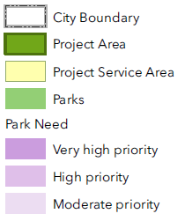
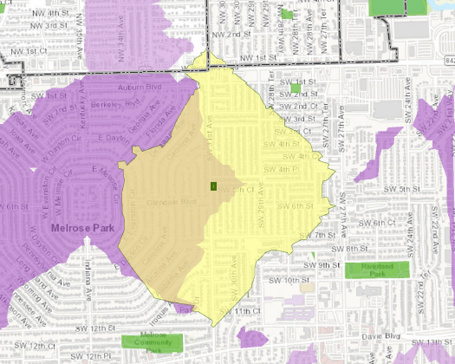
Park Designation of City-owned Property - 520 SW 31st Avenue
WHY?
In “very high priority” area of need (The Trust for Public Land, 2022)
Increases the percentage of neighbors within a 10-minute walking to a park from 77.2% to 78.2% (Additional 1,546 neighbors served by park designation)
Adds approximate 7,747 square feet to existing recreational space
This parcel would be at no charge to the acquisition portion of the City parks bond
NEXT STEPS
Present to City Commission for review on April 19, 2022
QUESTIONS?

Slide 2
